Slide 1
Software Engineering
Topic 7
Software Configuration Management

Slide 2
Acknowledgement
These slides have been adapted from
Pressman, R.S. (2015). Software Engineering : A Practioner's Approach. 8th ed. McGraw-Hill Companies.Inc, Americas, New York. ISBN : 978 1 259 253157. Chapter 23, 24, 25, 26 and 27

Slide 3
Learning Objectives
LO 4 : Analyze the software project
management and the proposed potential
business project

Slide 4
Contents
The Software Configuration
SCM Repository
The SCM Process
Configuration Management for Web and Mobile Apps

Slide 5
The Software Configuration
programs
documents
The pieces
data

Slide 6
The Software Configuration
Baselines
The IEEE (IEEE Std. No. 610.12-1990) defines a baseline as:
  A specification or product that has been formally reviewed and agreed upon, that thereafter serves as the basis for further development, and that can be changed only through formal change control procedures.
a baseline is a milestone in the development of software that is marked by the delivery of one or more software configuration items and the approval of these SCIs that is obtained through a formal technical review

Slide 7
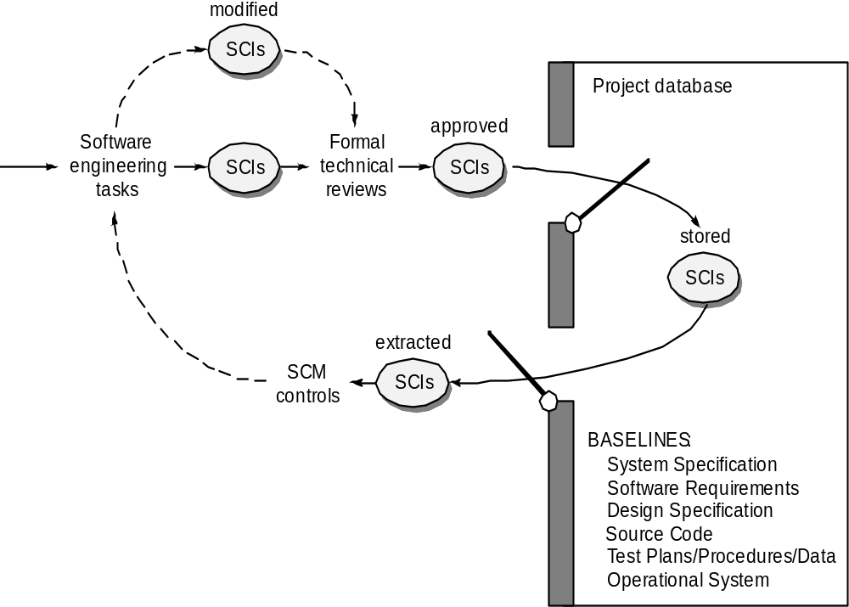
The Software Configuration
Baselines

Slide 8
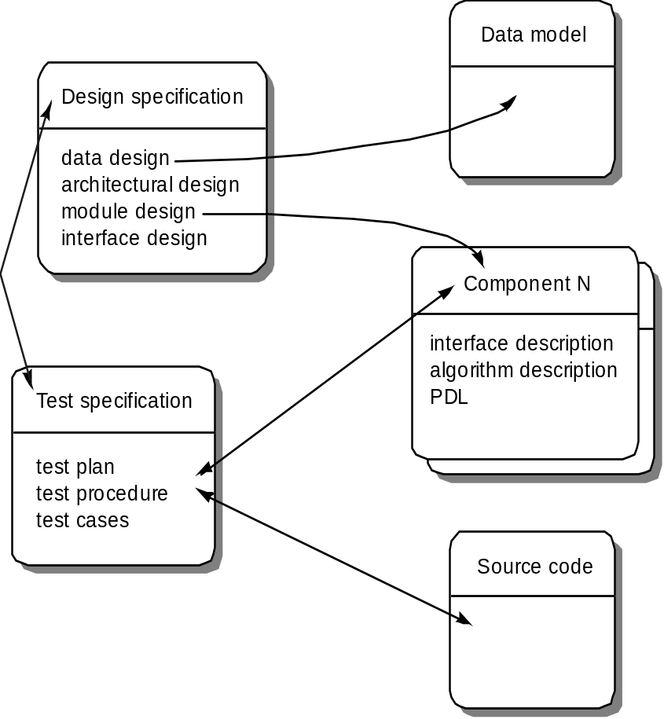
The Software Configuration
Software Configuration Objects

Slide 9
SCM Repository
The SCM repository is the set of mechanisms and data structures that allow a software team to manage change in an effective manner
The repository performs or precipitates the following functions [For89]:
  Data integrity
  Information sharing
  Tool integration
  Data integration
  Methodology enforcement
  Document standardization

Slide 10
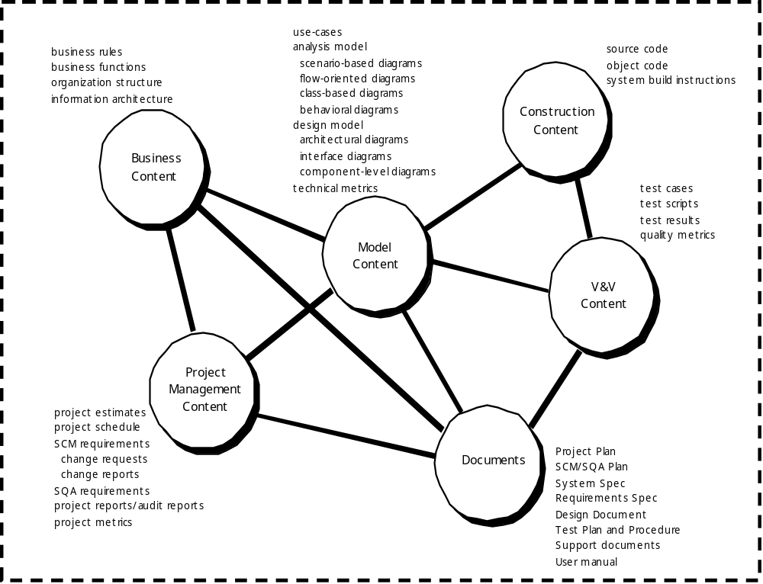
The Software Configuration
Repository Content

Slide 11
The Software Configuration
Repository Features
Versioning.
  saves all of these versions to enable effective management of product releases and to permit developers to go back to previous versions
Dependency tracking and change management.
  The repository manages a wide variety of relationships among the data elements stored in it.
Requirements tracing.
  Provides the ability to track all the design and construction components and deliverables that result from a specific requirement specification
Configuration management.
  Keeps track of a series of configurations representing specific project milestones or production releases. Version management provides the needed versions, and link management keeps track of interdependencies.
Audit trails.
  establishes additional information about when, why, and by whom changes are made.

Slide 12
The Software Configuration
SCM Elements
Component elements—a set of tools coupled within a file management system (e.g., a database) that enables access to and management of each software configuration item.
Process elements—a collection of procedures and tasks that define an effective approach to change management (and related activities) for all constituencies involved in the management, engineering and use of computer software.
Construction elements—a set of tools that automate the construction of software by ensuring that the proper set of validated components (i.e., the correct version) have been assembled.
Human elements—to implement effective SCM, the software team uses a set of tools and process features (encompassing other CM elements)

Slide 13

The SCM Process

Slide 14
The SCM Process
Change Control
STOP

Slide 15
The SCM Process
Change Control Process—I
Need for change is recognized
Change request from user
Developer evaluates
Change report is generated
Change control authority decides
Request is queued for action
Change request is denied
Change control process—II
User is informed

Slide 16
The SCM Process
Request is queued for action
Assign individuals to configuration objects
Change Control Process-II
“Check-out” configuration objects
Make the change
Review (audit )the change
“Check in” the configuration items that have been changed
Establish a baseline for testing
change control process—III

Slide 17
The SCM Process
Change Control Process-III
Perform quality assurance and testing activities
“Promote” changes for inclusion in next release (revision)
Rebuild appropriate version of software
Review (audit) the change to all configuration items
Include changes in new version
Distribute the new version

Slide 18
The SCM Process
Auditing
Change
Requests
SQA
Plan
SCIs
SCM Audit

Slide 19
The SCM Process
Status Accounting
Change
Reports
Change
Requests
ECOs
SCIs
Status Accounting
Reporting

Slide 20
Configuration Management for Web and MobileApps
Content.
  A typical WebApp contains a vast array of content—text, graphics, applets, scripts, audio/video files, forms, active page elements, tables, streaming data, and many others.
  The challenge is to organize this sea of content into a rational set of configuration objects and then establish appropriate configuration control mechanisms for these objects.
People.
  Because a significant percentage of WebApp development continues to be conducted in an ad hoc manner, any person involved in the WebApp can (and often does) create content.

Slide 21
Configuration Management for Web and MobileApps
Scalability.
  As size and complexity grow, small changes can have far-reaching and unintended affects that can be problematic. Therefore, the rigor of configuration control mechanisms should be directly proportional to application scale.
Politics.
  Who ‘owns’ a WebApp?
  Who assumes responsibility for the accuracy of the information on the Web site?
  Who assures that quality control processes have been followed before information is published to the site?
  Who is responsible for making changes?
  Who assumes the cost of change?

Slide 22
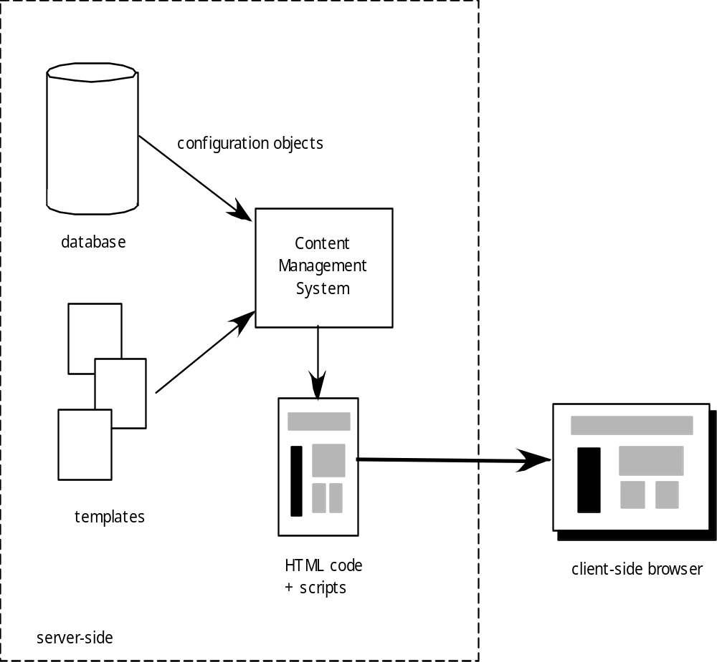
Configuration Management for Web and MobileApps
Content Management

Slide 23
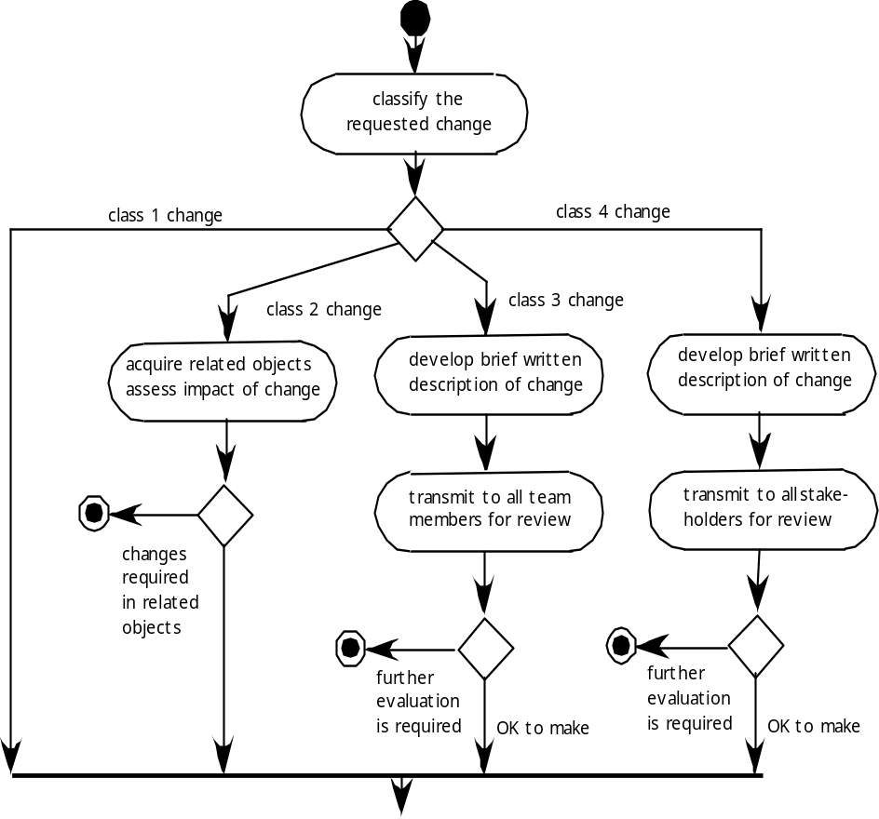
Configuration Management for Web and MobileApps
Change Management for WebApps-I

Slide 24
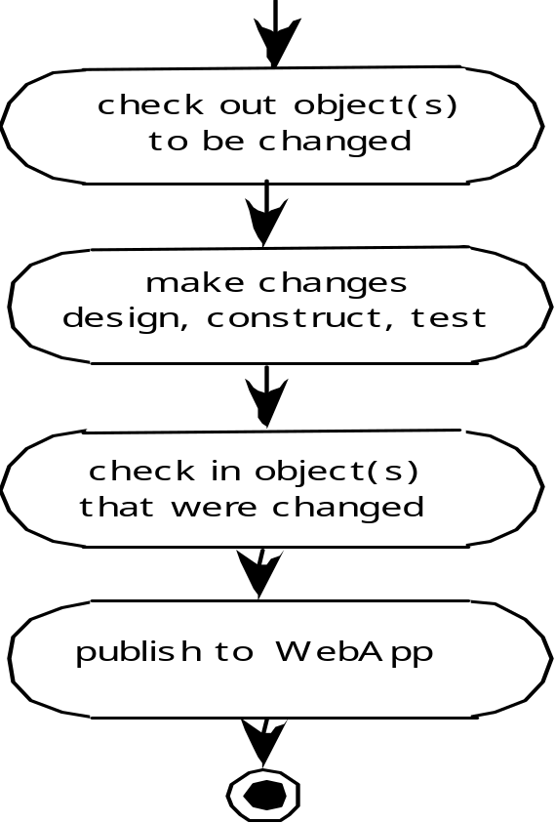
Configuration Management for Web and MobileApps
Change Management for WebApps-II

Slide 25
Case Study (1)
Software configuration process is also part of the ITSM (IT Software Management). The popular methodology is ITIL (IT Infrastructure Library)
In the practical development and operation, the team usually apply the integrated software development tools

Slide 26
Case Study (2)
The most popular tools is JIRA, which have the following features:
  Plan
  Track
  Release
  Report
In the release software, we can define the release version, status, progress, start date and release date.

Slide 27
References
Pressman, R.S. (2015). Software Engineering : A Practioner's Approach. 8th ed. McGraw-Hill Companies.Inc, Americas, New York. ISBN : 978 1 259 253157.
Software Testing
http://www.io.com/~wazmo/qa/
SW Testing Storm
http://www.mtsu.edu/~storm
Conventional sw testing
http://www.testingexcellence.com/conventional-software-testing-on-an-extreme-programming-team/
Testing OO SW
http://diwww.epfl.ch/researchlgl/research/ongoing/testing.html
Web testing
http://www.manageengine.com/products/qengine/web-testing.html

Slide 28
Q & A

